Slide 1


CORPORATE PROFILE • 2026
COLOMBO • SRI LANKA
ONE-STOP CORPORATE & FINANCIAL ADVISORY
COMPLIANCE. ASSURANCE.
Accelerate Growth.
Spillburg Corporate Services (Private) Limited is your trusted partner for sustainable growth. We assist global enterprises, multinational corporations, and investors with comprehensive internal audit, taxation, accounting, company secretarial, due diligence, M&A, stock market listing, and workforce solutions.
15+
200+
200+
100%
YEARS EXPERIENCE
GLOBAL CLIENTS
SUCCESSFUL PROJECTS
SATISFACTION RATE
Office 14, Basement Level, Cinnamon Lakeside Hotel, Colombo 02 | www.spillburgcorporate.com | info@spillburg.com

Slide 2
COMPLIANCE. ASSURANCE. ACCELERATE GROWTH.
SECTION 01 • CORPORATE IDENTITY
THE SPILLBURG STORY • WHO WE ARE
One-Stop-Shop Corporate Solutions
Founded over 15 years ago, Spillburg Corporate Services (Private) Limited was built on a singular premise: businesses expanding into or operating within Sri Lanka deserve a single, reliable partner capable of handling complex regulatory, financial, secretarial, and operational mandates under one roof.
Combining deep local regulatory intelligence across the ROC, BOI, IRD, CBSL, and CSE with global best practices, we have set up over 150 business ventures during the last 10 years.
OUR MISSION
OUR VISION
To empower global and local enterprises with seamless, accurate, and compliant corporate services—transforming complex regulatory challenges into strategic advantages.
To be the undisputed premier corporate services and transaction advisory partner in Sri Lanka, recognized globally for unwavering integrity and precision.
WHO WE SERVE • 150+ BUSINESS VENTURES ESTABLISHED IN THE LAST 10 YEARS
01. International Investors
02. Multinational Companies
03. Growing SMEs
Foreign promoters & funds entering Sri Lanka via BOI or normal law.
Global subsidiaries needing local IFRS accounting, tax & compliance.
Domestic enterprises looking for outsourced finance, tax & HR.
04. High-Growth Startups
05. Project Developers
06. Expatriate Executives
Founders incorporating and establishing compliant operations.
Infrastructure & hospitality sponsors requiring structuring & DD.
Foreign professionals requiring visa, personal tax & corporate support.
PRINCIPLES OF OUR WORK
Accuracy
Compliance
Confidentiality
Timeliness
Insight
Zero error tolerance across all records.
Strict adherence to local & IFRS rules.
Fiduciary-grade client data security.
On-schedule statutory filings & reports.
Actionable commercial intelligence.
SPILLBURG CORPORATE SERVICES (PVT) LTD | WWW.SPILLBURGCORPORATE.COM
PAGE 02

Slide 3
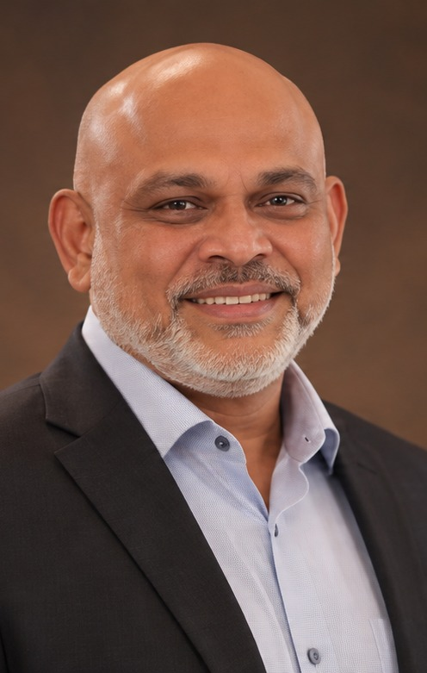
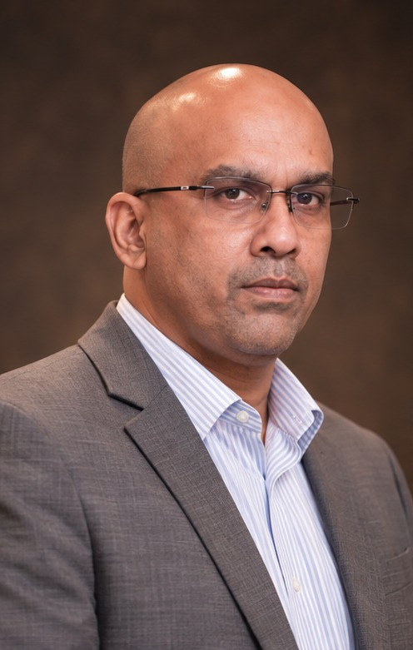
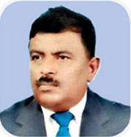
COMPLIANCE. ASSURANCE. ACCELERATE GROWTH.
SECTION 02 • EXECUTIVE LEADERSHIP
GOVERNANCE & SENIOR PARTNERS
Leadership & Advisory Team
M H K M Hameez
MANAGING DIRECTOR
BSc. (Hons) University of London • CPM (London) • CPA (Australia)
Former Director attached to the Investment Promotions Division of the Board of Investment (BOI) of Sri Lanka, bringing over 15 years of hands-on experience setting up projects, corporate structuring, financial due diligence, and cross-border investment advisory across SAFTA, ISLFTA, and SLPFTA.
Mohideen Shaameel (JP)
DIRECTOR / CEO
MABE (UK) • MBA (Sydney) • CMA (Australia) • FCPM • AM SLIM • JP
Former trade and corporate banker attached to HSBC and Standard Chartered Bank with over 15 years of senior executive experience in project financing, M&A deal structuring, BOI & Port City regulatory approvals, capital market readiness, and international investor facilitation.
N H Hameez
SENIOR TAX & AUDIT CONSULTANT
NHH
ACA • CPA
Associate Chartered Accountant (ACA) • Certified Practising Accountant (CPA)
Over 15 years of specialized public practice and corporate advisory experience guiding multinational corporations, mega infrastructure projects, and SMEs on IFRS financial reporting, statutory & internal auditing, RAMIS corporate tax compliance, VAT/APIT planning, and IRD tax appeal representation.
M. I. Razik
DIRECTOR – LEGAL & SECRETARIAL
Attorney-at-Law (Sri Lanka) • Commissioner for Oaths • Notary Public
Over 30 years of distinguished legal practice specialising in corporate and commercial law, Companies Act secretarial governance, M&A legal due diligence, shareholder & joint-venture agreements, property conveyancing, and commercial arbitration & dispute resolution.
SPILLBURG CORPORATE SERVICES (PVT) LTD | WWW.SPILLBURGCORPORATE.COM
PAGE 03

Slide 4
COMPLIANCE. ASSURANCE. ACCELERATE GROWTH.
SECTION 03 • CORE PRACTICE AREAS (I)
CORE SERVICES PORTFOLIO • PART I (01 – 04)
Finance, Tax, Audit & Workforce
FINANCIAL INTELLIGENCE & CONTROL
01
STRATEGIC PLANNING & FISCAL ADHERENCE
02
Accounting & Finance
Taxation Advisory
Rigorous bookkeeping and reconciliation discipline with executive-level reporting aligned with SLFRS / IFRS and GAAP standards.
• Full-Spectrum Bookkeeping & Statutory Financial Statements
• Monthly Management Accounts & Financial KPIs
• Financial & Cashflow Analysis & Forecasting Models
• Turnkey Outsourced Finance Department Operations
Forward-thinking tax planning and IRD representation that protects your bottom line while maintaining 100% statutory compliance.
• Corporate Income Tax (CIT) & Annual Returns
• VAT, SVAT, PAYE / APIT & WHT Filings
• TIN & IRD RAMIS e-Services Registration
• Strategic Tax Planning & Tax Appeal Representation
GOVERNANCE & INDEPENDENT ASSURANCE
03
TURNKEY WORKFORCE MANAGEMENT
04
Audit & Assurance
Payroll & HR Services
Independent assurance and 360° internal control evaluations to safeguard enterprise value and eliminate operational vulnerabilities.
• External Statutory Audit Coordination
• Internal Audit & Forensic Reviews
• Financial Controls & Enterprise Risk Assessment
• Statutory Compliance & Board Governance Advisory
Frictionless, 100% confidential payroll processing, meticulous documentation, and compliant Sri Lankan employment practices.
• Monthly Payroll Processing, Bank Files & Payslips
• EPF & ETF Statutory Contributions (C-Forms)
• Standardized Employment Contracts & Onboarding
• Shop & Office Act Compliance & Expatriate Visas
SPILLBURG CORPORATE SERVICES (PVT) LTD | WWW.SPILLBURGCORPORATE.COM
PAGE 04

Slide 5
COMPLIANCE. ASSURANCE. ACCELERATE GROWTH.
SECTION 04 • CORE PRACTICE AREAS (II)
CORE SERVICES PORTFOLIO • PART II (05 – 08)
Transactions, IPOs & Arbitration
RISK ASSESSMENT & INVESTMENT INTELLIGENCE
05
STRATEGIC TRANSACTIONS & RESTRUCTURING
06
Due Diligence (DD)
M&A & Takeovers
Independent, forensic-grade investigations giving investors, acquirers, and boards 360° visibility into counterparty risk.
• Financial & Quality-of-Earnings (QoE) Due Diligence
• Legal, Regulatory & Contractual Due Diligence
• Operational, Commercial & Tax Exposure DD
• Vendor DD, Red Flag Reviews & Risk Registers
Strategic counsel across the full deal lifecycle—from target identification and valuation through negotiation and closing.
• Buy-Side & Sell-Side M&A Transaction Advisory
• Independent Business Valuations & Fairness Opinions
• Deal Structuring, Term Sheets & Takeover Defense
• CBSL, SEC & BOI Regulatory Approvals & Post-Merger
CAPITAL MARKETS & IPO ADVISORY
07
DISPUTE RESOLUTION & RISK MITIGATION
08
Stock Market Listing
Mitigation & Arbitration
End-to-end coordination with stockbrokers, lawyers, auditors, SEC, and the Colombo Stock Exchange (CSE).
• IPO Readiness Assessment & Gap Remediation
• Pre-Listing Corporate & Financial Restructuring
• Prospectus Preparation & SEC / CSE Submissions
• Pre-IPO Investor Relations, Post-Listing & Rights Issues
Forensic financial analysis, contractual risk assessment, and representation across Sri Lanka’s arbitration framework.
• Commercial Arbitration, Mediation & Conciliation
• Independent Financial & Quantum Expert Witness
• Pre-Dispute Contractual Risk Audits
• Regulatory Dispute Navigation & Settlement Advisory
SPILLBURG CORPORATE SERVICES (PVT) LTD | WWW.SPILLBURGCORPORATE.COM
PAGE 05

Slide 6
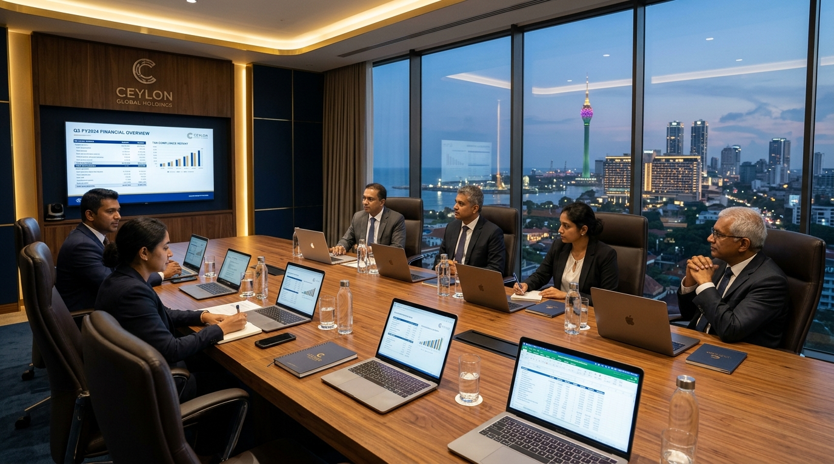
COMPLIANCE. ASSURANCE. ACCELERATE GROWTH.
SECTION 05 • SECRETARIAL & MARKET ENTRY
UNCOMPROMISING CORPORATE EXCELLENCE
Entity Incorporation & Secretarial Lifecycle
PHASE I: INCORPORATION & LICENSING
PHASE II: ONGOING SECRETARIAL
• Name reservation via Department of Registrar of Companies (ROC eBiz)
• Drafting bespoke Articles of Association & Shareholder Agreements
• Private Limited, Public Limited, Overseas Branch & Offshore setups
• BOI Section 17 / 16 approvals & CBSL Inward Investment Account (IIA) setup
• Acting as Named Registered Company Secretary & Registered Office
• Filing Annual Returns (Form 15) & maintaining Statutory Registers
• Share allotments (Form 6), transfers, buybacks & capital reductions
• Board & AGM minutes, resolutions & director changes (Form 20)
WHY GLOBAL ENTERPRISES CHOOSE SPILLBURG CORPORATE SERVICES
01. RELIABLE & PROVEN — A service-oriented firm ensuring absolute delivery and flawless execution on every corporate engagement.
02. IMPECCABLE TRUST — Unwavering commitment to confidentiality and fiduciary integrity to safeguard our clients' interests.
03. FRICTIONLESS EXPANSION — Seasoned experts rapidly navigate complex bureaucratic requirements so your operations are hassle-free.
04. BESPOKE ATTENTION — We dedicate time to deeply understand your corporate architecture, deploying strategically tailored plans.
SPILLBURG CORPORATE SERVICES (PVT) LTD | WWW.SPILLBURGCORPORATE.COM
PAGE 06

Slide 7
COMPLIANCE. ASSURANCE. ACCELERATE GROWTH.
SECTION 06 • REGULATORY ECOSYSTEM
SRI LANKAN STATUTORY & INSTITUTIONAL DIRECTORY
Regulatory & Institutional Ecosystem
01 • GOVERNMENT & CORPORATE PORTALS
02 • FINANCIAL & AUDIT REGULATORS
• Dept. of Registrar of Companies (ROC eBiz) — drc.gov.lk
• Board of Investment of Sri Lanka (BOI) — investsrilanka.com
• Sri Lanka Export Development Board (EDB) — srilankabusiness.com
• Department of Labour — labourdept.gov.lk
• Central Bank of Sri Lanka (CBSL) — cbsl.gov.lk
• Securities & Exchange Commission (SEC) — sec.gov.lk
• SL Accounting & Auditing Standards Board — slaasmb.gov.lk
• Employees' Provident Fund (EPF) — epf.lk
03 • TAXATION & REVENUE AUTHORITIES
04 • CAPITAL MARKETS & ARBITRATION
• Inland Revenue Department (IRD) — ird.gov.lk
• IRD RAMIS e-Services Portal — eservices.ird.gov.lk
• Sri Lanka Customs — customs.gov.lk
• Ministry of Finance / Treasury — treasury.gov.lk
• Colombo Stock Exchange (CSE) & CDS — cse.lk / cds.lk
• SL National Arbitration Centre (SLNAC) — slnac.org.lk
• ICLP Arbitration Centre — iclp.lk
• Bar Association of Sri Lanka (BASL) — basl.lk
CONTINUOUS REGULATORY INTELLIGENCE: Our technical desk actively tracks real-time gazettes, Inland Revenue circulars, Central Bank Monetary Policy Reviews, and Colombo Stock Exchange listing rule updates so our clients remain ahead of every statutory change.
SPILLBURG CORPORATE SERVICES (PVT) LTD | WWW.SPILLBURGCORPORATE.COM
PAGE 07

Slide 8





COMPLIANCE. ASSURANCE. ACCELERATE GROWTH.
SECTION 07 • CLIENT SUCCESS STORIES
ENDURING PARTNERSHIPS • VERIFIED TRACK RECORD
Client Testimonials & Success Stories
“We have been using Spillburg services for more than 10 years and have always been completely satisfied with their commitment and overall performance. Knowledgeable, courteous and accessible at any time.”
“I have been using Spillburg for a long time now and their service is punctual and efficient. They have a ‘can do’ and ‘work with’ attitude and approach. I would highly recommend them.”
Maneevannan Bhakthavathsalu
Ross Mayles
Country Director, ECU World Wide Lanka (Pvt) Ltd
Director, RDM Investments (Pvt) Ltd
“Spillburg Corporate Services is a reliable partner on the way to the success of the company. We are happy to walk together for eight years. Always finds ways and solutions to complex problems.”
“Spillburg Corporate Services has provided us professional services for more than 8 years in Sri Lanka. All the staff are accessible and well educated along with adequate knowledge.”
Sergey Mikheev
Qu Yucai
Founder & CEO, Surf Discovery Lanka (Private) Limited
General Manager, Yanjian Group Lanka (Pvt) Ltd
“Professional, efficient and get the job done. Have no hesitation in recommending them for corporate and advisory mandates.”
“Thank you for the excellent corporate secretarial, accounting, and compliance service—greatly appreciated by our board.”
Mr. Shabbir Abidali Jafferjee
Mark Butson
Chairman, Serendib Properties Group of Companies
Director, Sharafi Lanka (Pvt) Ltd
SPILLBURG CORPORATE SERVICES (PVT) LTD | WWW.SPILLBURGCORPORATE.COM
PAGE 08

Slide 9
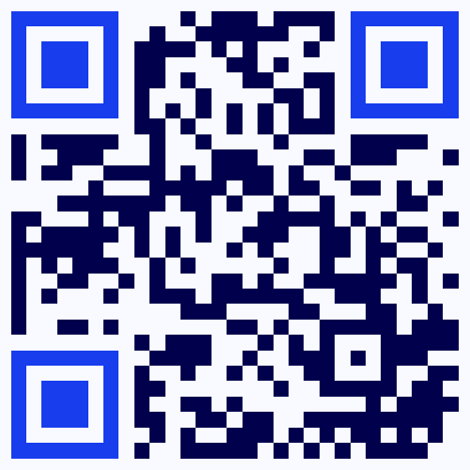
COMPLIANCE. ASSURANCE. ACCELERATE GROWTH.
SECTION 08 • EXECUTIVE CONTACT
START A CONVERSATION • LET'S SHAPE YOUR FUTURE
Consult With Our Experts
Spillburg Corporate Services (Private) Limited
REGISTERED OFFICE LOCATION:
Office 14, Basement Level, Cinnamon Lakeside Hotel,
No. 115, Sir Chittampalam A. Gardiner Mawatha,
Colombo 02, Sri Lanka.
DIRECT TELEPHONE & FACSIMILE:
Telephone: +94 11 233 6116
Hotlines: +94 77 779 0919 | +94 77 748 7720
Facsimile: +94 11 252 9309
OFFICIAL EMAIL & WEB PORTAL:
Email: info@spillburg.com
Website: www.spillburgcorporate.com
SCAN TO VISIT WEBSITE
spillburgcorporate.com
YOUR TRUSTED PARTNER FOR SUSTAINABLE GROWTH
“Compliance. Assurance. Accelerate Growth.”
15+ Years Experience • 200+ Global Clients • 200+ Successful Projects • 100% Satisfaction Rate
SPILLBURG CORPORATE SERVICES (PVT) LTD | WWW.SPILLBURGCORPORATE.COM
PAGE 09

